Slide 1
Move To Live
Pedro Lobo 1801815

Slide 2
Overview of your game
Top Down
Survive as long as possible, the game has no time limit
Enemy chickens go around randomly and kill you on collision, they increase in number and speed over time
You can pass over stop signs to decrease the speed of the chickens, making the game easier
There is a coin that you can activate to become immune for 3 seconds

Slide 3
Controls
Move with WASD and pause game with “P”
“Enter” on menu starts the game and “R” on game over menu restarts the game

Slide 4
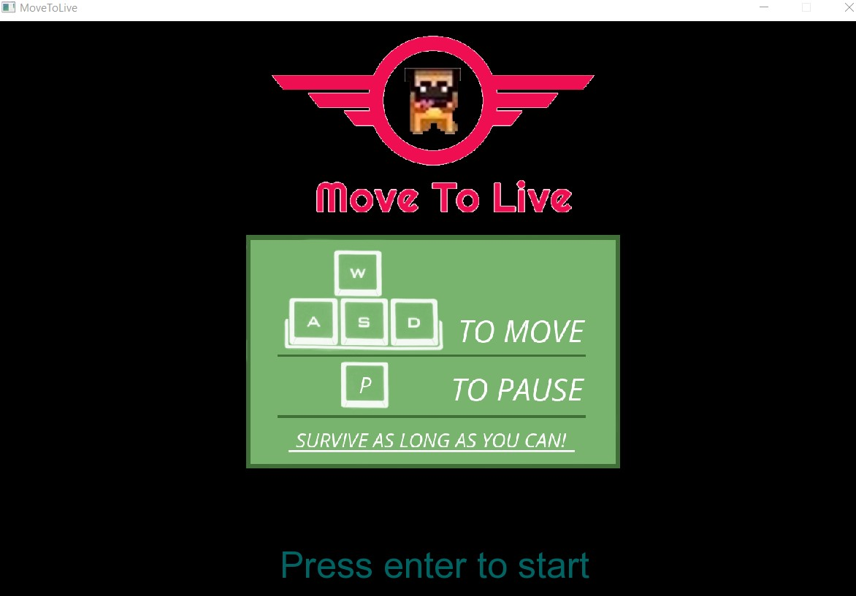
Game Screens
Menu screen with start game option, controls explanation and objective explanation

Slide 5
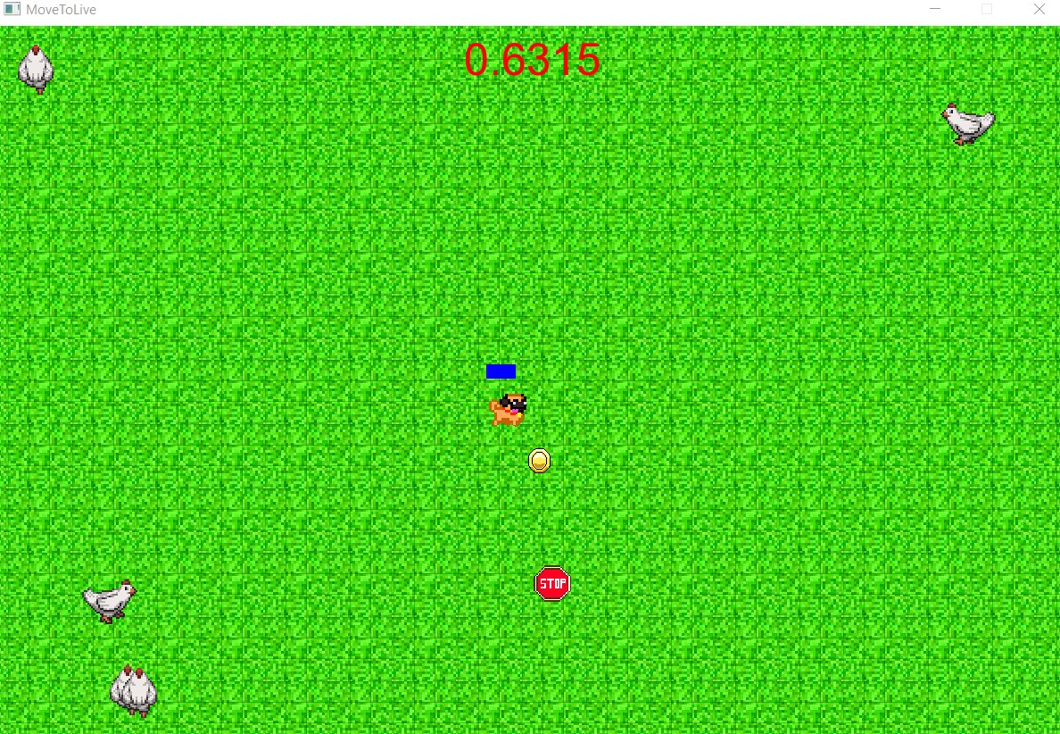
Game Screens
Game running

Slide 6
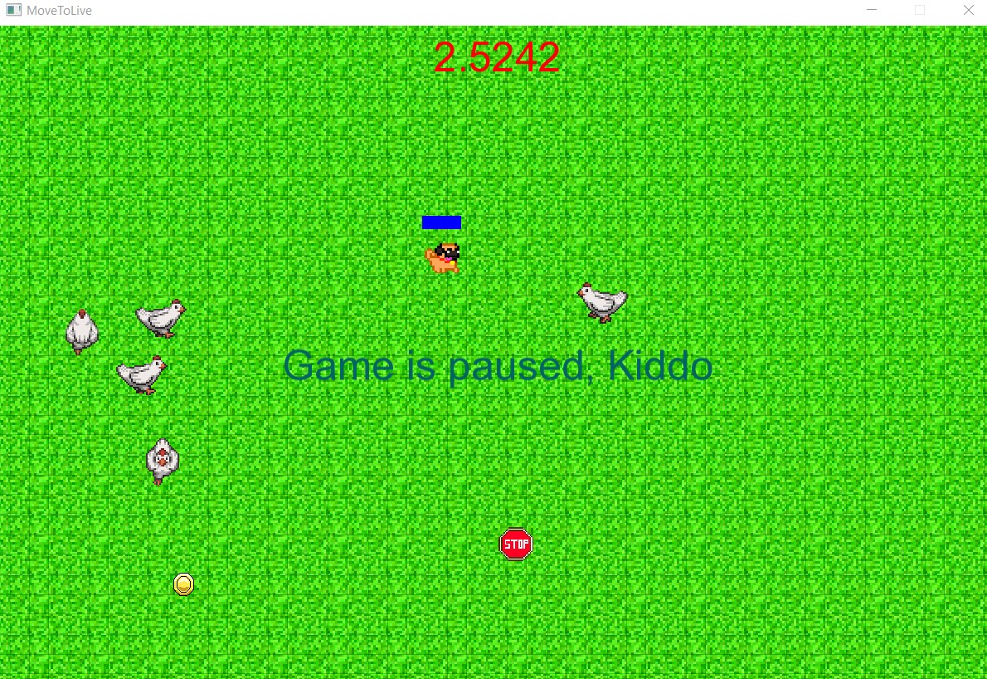
Game Screens
Game Paused

Slide 7
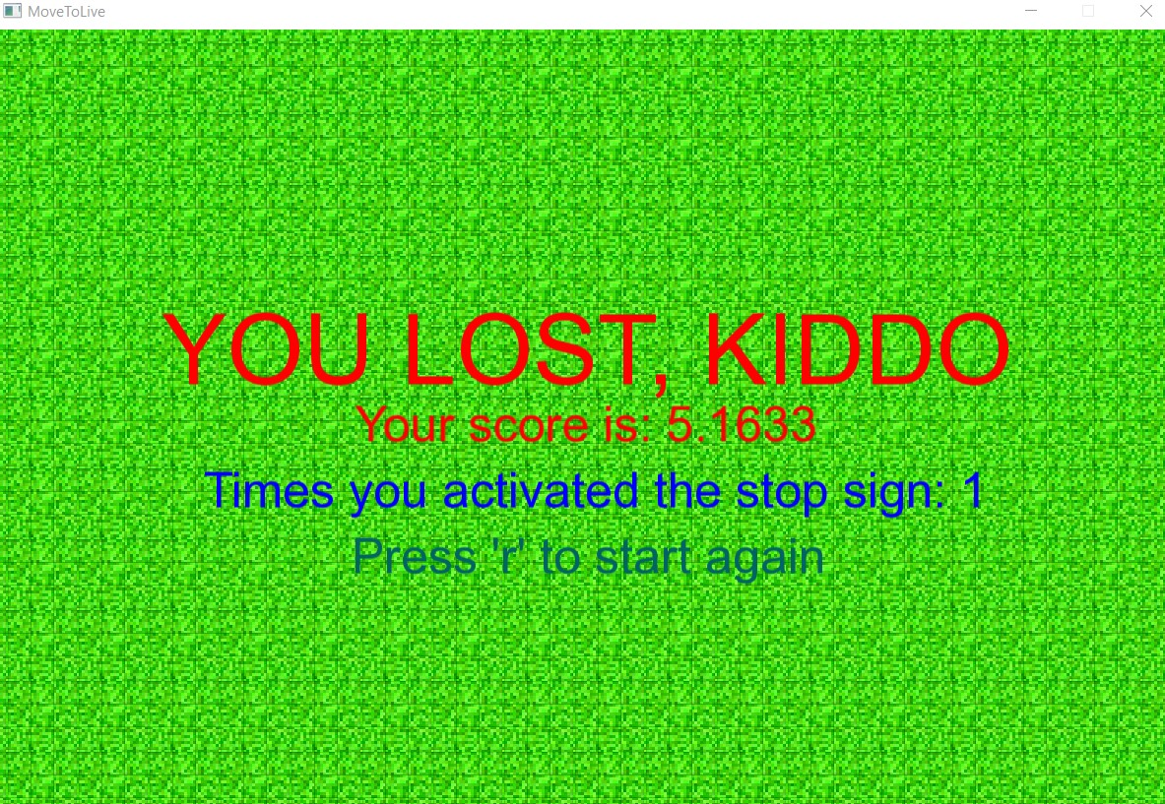
Game Screens
Game Over screen with game stats and instruction to restart game

Slide 8


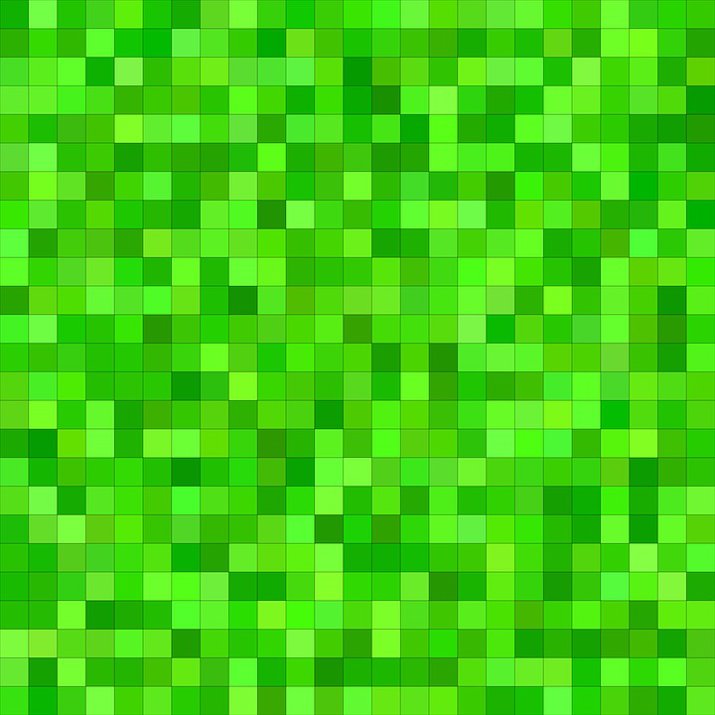
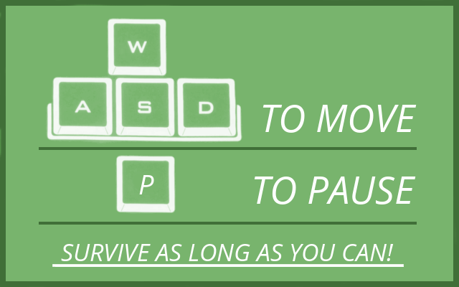


Sprite work
In order shown: player sprites, enemies, coin, stop sign, menu instructions, game logo and background image

Slide 9
Collision detection and resolution
In Level update I have a function to check the collision between all game elements, checkCollisions( ). This function compares hitboxes of objects with the function rectWithRect( ), a collision function that checks if two rectangles are intersecting. Then, it calls the appropriate function for the interaction:
Enemy with player: if player is not invincible, kill him
Stop sign with player: decrease enemies speed
Coin with player: make player invincible for 3 seconds
All game elements have a function getCollisionShape( ), which returns the hitbox of objects
Only enemies use a different getCollisionShape function for hitbox balancing purposes
Each object has it own class and inherits from Character class

Slide 10
Game logic
Time passes indefinitely, the object is to stay alive the maximum amount of time
Enemy chickens spawn overtime and gradually increase their speed, they kill you on collision
The movement of the player can move freely. He/she must keep moving in order to avoid his life getting to zero: staying still decreases life; moving increases it until max life
Player has three possible interactions:
Colliding with stop sign to decrease the speed of enemies
Colliding with coin to gain invincibility for 3 seconds
Colliding with enemy and dying

Slide 11
References
All artwork used here is properly described in license document inside game files as demanded by their intellectual property licenses
Game on inspired on the masterpiece game Move Or Die
Sounds:
"ubermensch" made by Cleyton Kauffman
"pentatonic" made by Ctskelgysth Inauaruat
"start" made by needforbleed
"crow" made by zeroisnotnull
"coin" made by madcowj
Images:
AntumDeluge (https://opengameart.org/content/pug-rework) and (https://opengameart.org/content/lpc-chicken-rework)
Kungfu4000
Madcowj
Invincible

